Slide 1
SecurePi: A Raspberry Pi-Based Smart Security and Notification System
Group 14:61375070H_黃柏瑜 61375082H_林聖倫 61375017H_陳昕佑

Slide 2
TABLE OF CONTENTS
01
05
02
06
03
04
Storyline
Job role
Software Function
Gantt Chart
Hardware Specification
07
code
Total Cost
Demo
08

Slide 3
Storyline
01

Slide 4
Storyline
The core concept of this project is to develop an "Intelligent Surveillance System" capable of automatically detecting suspicious individuals or activities, capturing images/video, and sending alerts via SMS to administrators. In addition, various sensors (such as PIR motion sensor)will be integrated to monitor environmental conditions, ensuring real-time and accurate anomaly detection.

Slide 5
Storyline
Key Objectives:
Automatically detect suspicious persons or intrusions and promptly notify the administrator.
Integrate multiple sensors to provide more comprehensive environmental data.
Send alarm notifications via SMS or other methods to enhance mobility and responsiveness.
Display warning information and sensor readings for convenient monitoring and operation.

Slide 6
Software Function
02

Slide 7
System Flow Description
1.System waits in IDLE mode, shown on LED
2.PIR detects motion → start camera
3.YOLOv11 processes frame → checks if person detected
4.If person present >10s:
1.LED scrolls “WARNING“ 2.Email sent with image
5.If no person for > 3s after detection:
1.LED scrolls “CLEAR” 2.Email sent with snapshot

Slide 8
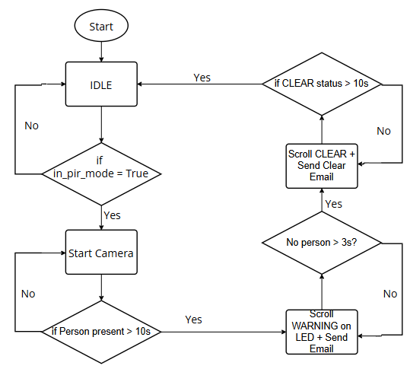
System Flow Chart

Slide 9
Hardware Specification
03

Slide 10
Devices
Raspberry Pi 5: Acts as the central processor, handling sensor data, YOLO inference, email transmission, and LED display control. Runs Linux OS and uses Python for system management .
USB Camera Module : A camera module supporting night vision for surveillance, photo, and video capture.
HC-SR501 PIR Sensor: Detects human movement and triggers the system to start capturing and recognition. Connected via GPIO 17.
MAX7219 8x8 LED Module: Controlled via SPI interface. Displays system states like IDLE, WARNING, and CLEAR using scrolling messages with LCD-style fonts.
GSM/4G Module : Enables SMS alerts

Slide 11
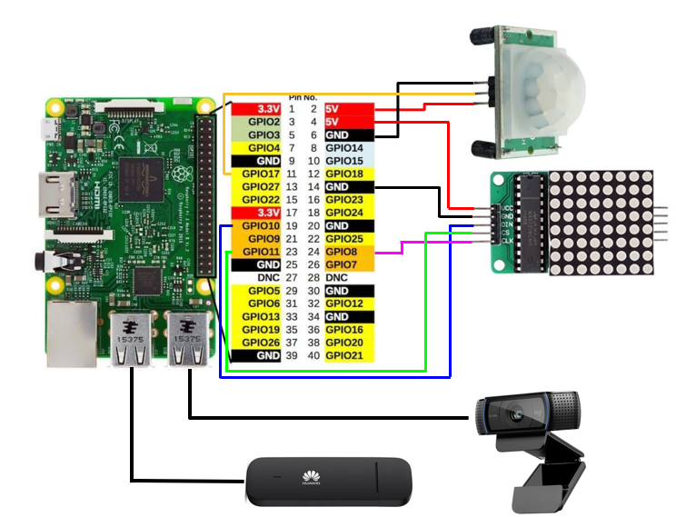
Devices

Slide 12
Specifications
Detection Distance/Range: The HC-SR501 can detect motion within 7-10 meters.
Image Resolution: The Camera Module 2 NoIR supports up to 8MP stills and 1080p/30fps video recording.
System Response Time: Detect anomaly → Send SMS in under 5 seconds (depending on network/GSM signal).
Power Requirements: Raspberry Pi 5 requires about 5V/3A; Arduino UNO runs on 5V/USB power supply.

Slide 13
Total Cost
04

Slide 14
Job role
05

Slide 15
Job role
Hardware and Sensor Integration (林聖倫) Responsible for wiring and sensors, including the HC-SR501 PIR sensor, the MAX7219 8x8 LED module , etc.
Raspberry Pi and Image Processing (黃柏瑜) Responsible for setting up the Raspberry Pi 5 and Camera Module 2 NoIR, using OpenCV or a similar framework for video detection and capture.
SMS Alert and Network Functionality (陳昕佑) In charge of integrating and programming the GSM/4G module or SMS API (such as Twilio), enabling automatic SMS alerts upon anomaly detection.

Slide 16
Gantt Chart
06

Slide 17
Gantt Chart
INITIATIVE | OBJECTIVE | Week 1 | Week 2 | Week 3 | Week 4 | Week 5 | Week 6
Preliminary Planning & Setup | - Confirm requirements & hardware list - Install Raspberry Pi OS/Arduino IDE - Test basic sensors & camera module
Sensor & Camera Integration | - Write sensor data reading scripts - Implement OpenCV for image processing - Verify data transmission to Pi
SMS Alert Functionality | - Test GSM/4G module or API - Implement SMS via AT commands/REST API - Integrate with detection workflow
Display & Data Storage | - Test MAX7219 LED display - Integrate alert message display - Design database or CSV logging mechanism
System Integration & Testing | - Conduct end-to-end functionality tests - Adjust detection sensitivity and parameters - Validate SMS reliability
Optimization & Debugging | - Refine detection algorithms - Debug hardware wiring and code logic - Finalize user guide & documentation

Slide 18
Code
07

Slide 19

Email Sending Functions
send_email_alert(): Sends a "WARNING" email with an image attachment when a person is continuously detected.
send_clear_email(): Sends a "CLEAR" email when no person has been detected for a specified duration

Slide 20
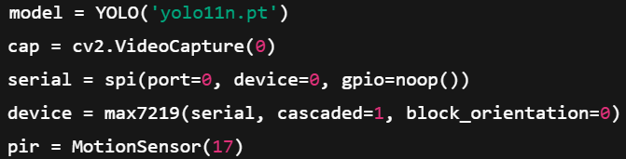
Device Initialization
Loads the YOLOv11 model (yolo11n.pt).
Opens the USB camera (index 0) with 320x240 resolution.
Initializes the MAX7219 LED matrix using SPI.
Initializes the PIR motion sensor on GPIO 17.

Slide 21
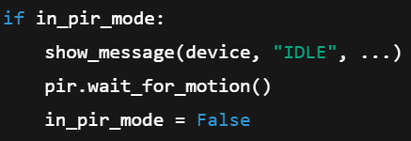
Main Loop Functionality
(1) Wait for Motion Detection
Displays “IDLE” on the LED screen while waiting for motion.
Once motion is detected, it transitions to detection mode.

Slide 22

Main Loop Functionality
.
(2) Frame Capture and Object Detection
Captures a frame from the camera.
Runs YOLO inference to detect objects (particularly person class).
Extracts class IDs from YOLO results and counts how many are class 0. (which refers to people)

Slide 23
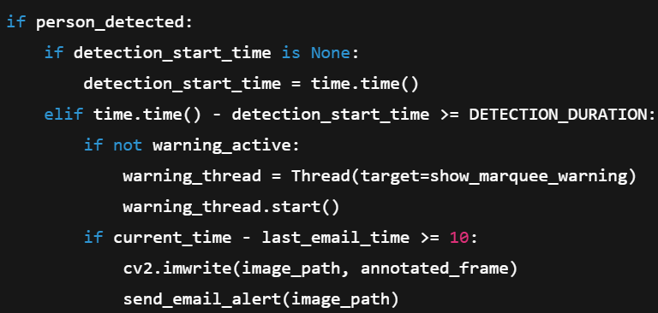
Main Loop Functionality
.
(3) Triggering Warning and Sending Email
If a person is continuously detected for more than 10 seconds:
Start LED “WARNING” scroll animation in a background thread.
Send an alert email with the captured image.

Slide 24
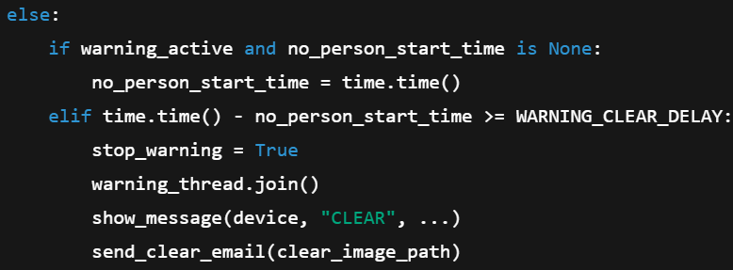
Main Loop Functionality
.
(4) Clearing the Alert State
If no person is detected for over 3 seconds:
Stop the “WARNING” message.
Display “CLEAR” on the LED matrix.
Send a “CLEAR” email with a snapshot.

Slide 25
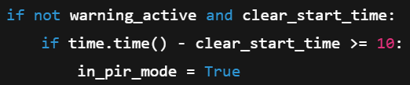
Main Loop Functionality
.
(5) Return to PIR Mode
After 10 seconds of clear status, the system re-enters idle mode, waiting for new PIR triggers.

Slide 26

Cleanup and Exit
.
Releases the camera resource and closes all OpenCV windows to cleanly exit the program.

Slide 27
Demo
08

Slide 28
Q&A

Slide 29
Goals
Improve system detection accuracy and reduce false alarms.
Implement real-time SMS alerts and display warning information on-screen.
Ensure hardware and software stability for continuous operation.
Integrate sensor data and camera footage effectively for comprehensive surveillance.

Slide 30
Challenges
Hardware integration and wiring: Multiple sensors and wireless modules add complexity.
Accuracy of image detection: Factors like ambient lighting and background noise must be managed.
Data synchronization: Stable and reliable data exchange between Arduino and Raspberry Pi is crucial.
GSM/SMS feasibility: If using SIM cards, signal strength and costs must be considered; if using a cloud API, a stable network connection is required.

